Slide 1
Secure Data Hiding in Image Using Steganography
CAPSTONE PROJECT
Presented By:
Student Name : Gopendra Nirmalkar
College Name : Shri Shankaracharya Technical Campus
Department : CSE(CYBERSECURITY)

Slide 2
OUTLINE
Problem Statement
Technology used
Wow factor
End users
Result
Conclusion
Git-hub Link
Future scope

Slide 3
Problem Statement
Currently, performing steganography (hiding data within other data) often requires technical expertise and the use of command-line tools or specialized software. This creates barriers for users who may need to securely share information without attracting unwanted attention but lack the technical skills or access to appropriate tools. There's a need for a user-friendly, accessible, and platform-independent solution that simplifies the process of embedding and extracting hidden data within digital files.
Specific Issues:
Lack of User-Friendly Interface: Existing tools are often complex, intimidating, and require technical knowledge to operate.
Platform Dependence: Many steganography tools are designed for specific operating systems, limiting accessibility.
Limited File Format Support: Some tools may not support a wide range of file formats for embedding and extraction.
Difficulty in Managing Keys and Passwords: Securely handling encryption keys and passwords is crucial for steganography, but current solutions may not provide intuitive management.
Lack of Visual Feedback: Users may find it challenging to understand the process and verify the successful embedding or extraction of data without visual feedback.
Security Concerns: Some existing web based tools are not secure, or do not offer the ability to encrypt the hidden data.

Slide 4
Technology used
Python: The core programming language used for the application.
Flask: A lightweight and flexible Python web framework used to build the web application. It handles routing, request handling, and response generation.
HTML/Templates: The render_template function suggests the use of HTML templates (likely Jinja2 templates, which Flask uses by default) for the index.html file, which defines the structure and content of the web page.
JavaScript (Implied): While not explicitly shown in the Python code, the use of jsonify and the handling of file uploads through request.files strongly imply the presence of JavaScript in the index.html file. JavaScript would be used for:
Handling file uploads.
Making AJAX requests to the /encode and /decode routes.
Dynamically updating the web page with the results.
File Handling (Python's built-in): The code uses Python's file handling capabilities to read and process uploaded files.
JSON: The jsonify function is used to return data in JSON format, which is a standard format for data exchange between web servers and clients.
Modules (encode.py and decode.py): The code imports functionalities from encode.py and decode.py. These modules presumably contain the actual steganography logic for encoding and decoding messages within images, audio, and video files.
HTTP: The web application uses the HTTP protocol for communication between the client (web browser) and the server.
Request/Response cycle: The code follows the standard request/response cycle of web applications, handling POST requests for encoding and decoding.

Slide 5
Wow factors
Multi-Media Support:
The code aims to handle steganography across three different media types: images, audio, and video. This broad support is a significant plus, as many steganography tools focus on a single media type.
Flask Web Framework:
Using Flask makes the application relatively lightweight and easy to deploy. Flask's simplicity allows for rapid prototyping and development, which is beneficial for building a proof-of-concept.
JSON API:
The use of jsonify to return data in JSON format is a modern and efficient approach. It allows for easy integration with JavaScript on the client-side, enabling dynamic updates and a more interactive user experience.
Modular Design:
The separation of encoding and decoding logic into separate modules (encode.py and decode.py) promotes code organization and maintainability. This modularity makes it easier to extend the application with new steganography algorithms or media types.
File Upload Handling:
The code manages file uploads, which is a core requirement for a steganography application.
Error Handling:
The code has some basic error handling, checking if the correct amount of files are uploaded. This is a very good start.

Slide 6
End users
General Users:
People who want to share personal photos or messages discreetly, perhaps to avoid unwanted attention on social media.
Individuals seeking to protect sensitive personal data.
Journalists and Activists:
Those working in environments with censorship or surveillance, needing to communicate securely with sources or share information.
Individuals seeking to protect whistleblowing activities.
2. Professionals Handling Sensitive Information:
Cybersecurity Professionals:
Using steganography for covert communication, hiding encryption keys, or watermarking digital assets.
Forensic analysts who might encounter steganography during investigations.
Law Enforcement:
Utilizing steganography for covert communication or to embed hidden identifiers in digital evidence.
3. Digital Content Creators and Distributors:
Photographers and Artists:
Embedding watermarks or copyright information within their digital creations.
Content Distributors:
Hiding metadata or tracking information within media files.
4. Hobbyists and Tech Enthusiasts:
Individuals interested in cryptography and information security:
Experimenting with steganography techniques for educational or personal projects.
People who enjoy puzzles and secret messaging:
Using steganography for fun and communication with friends.

Slide 7
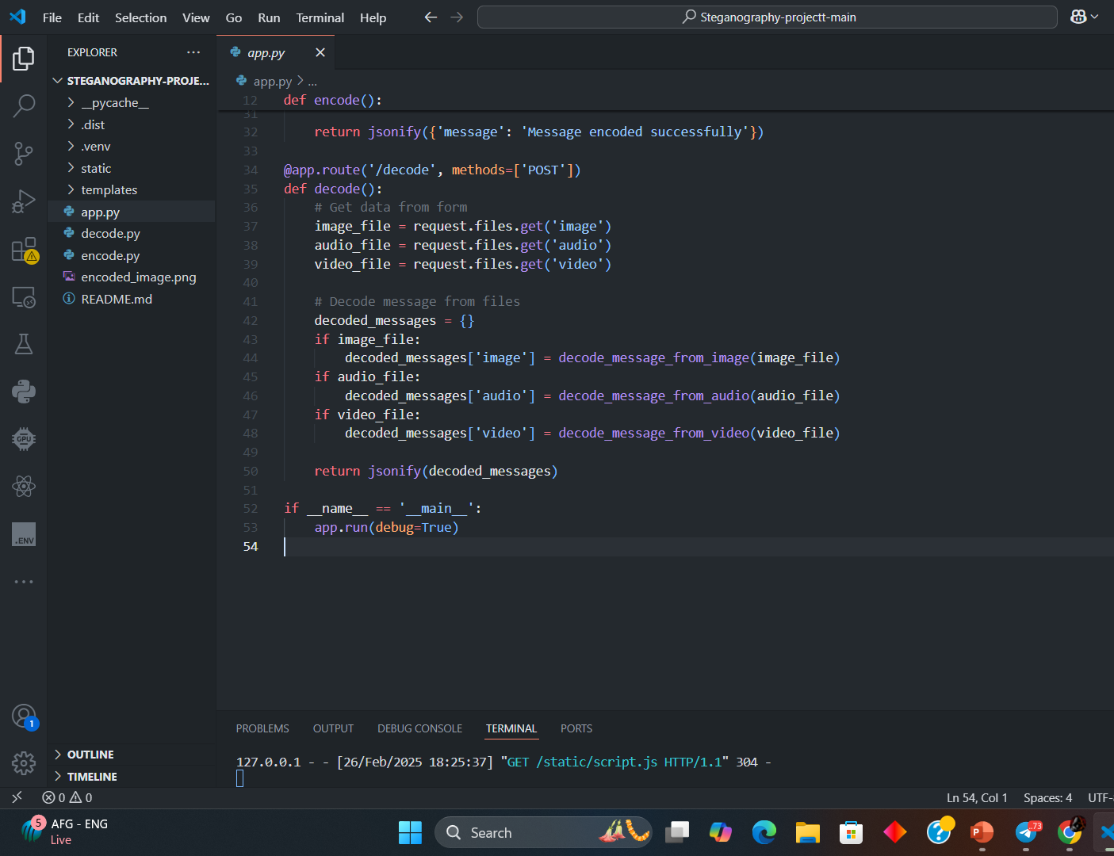
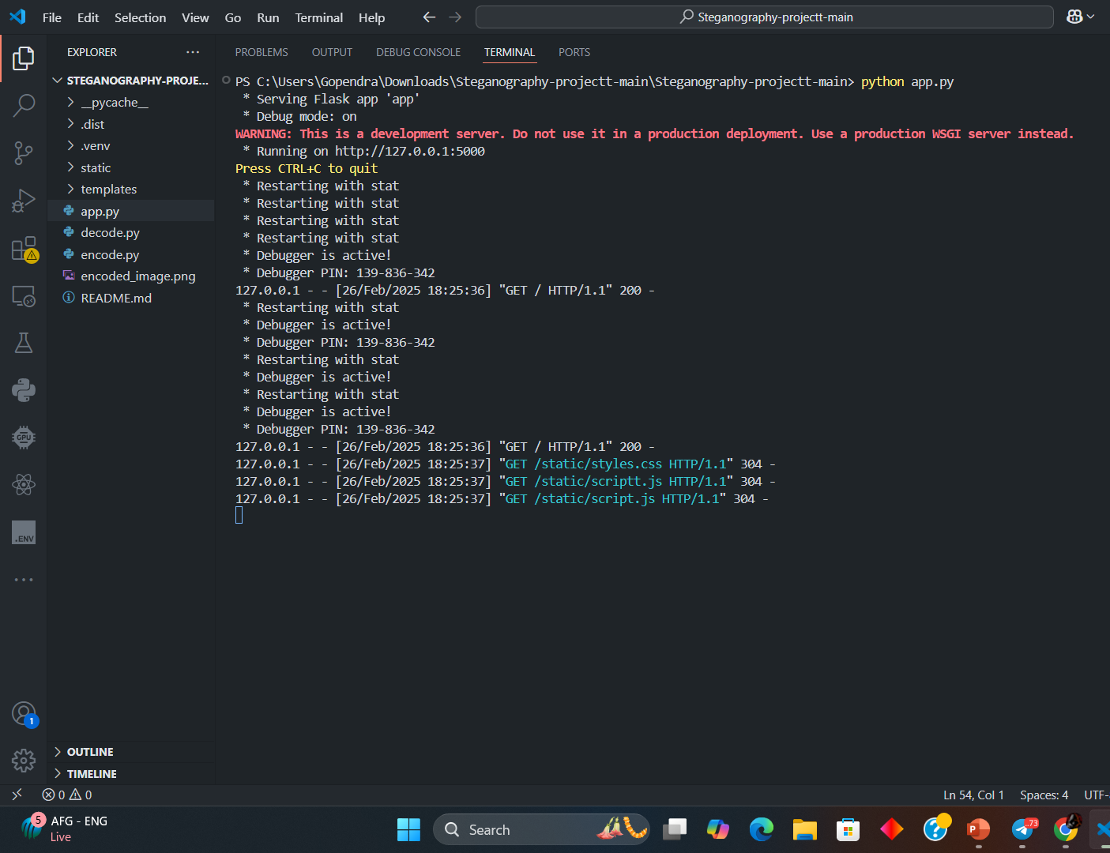
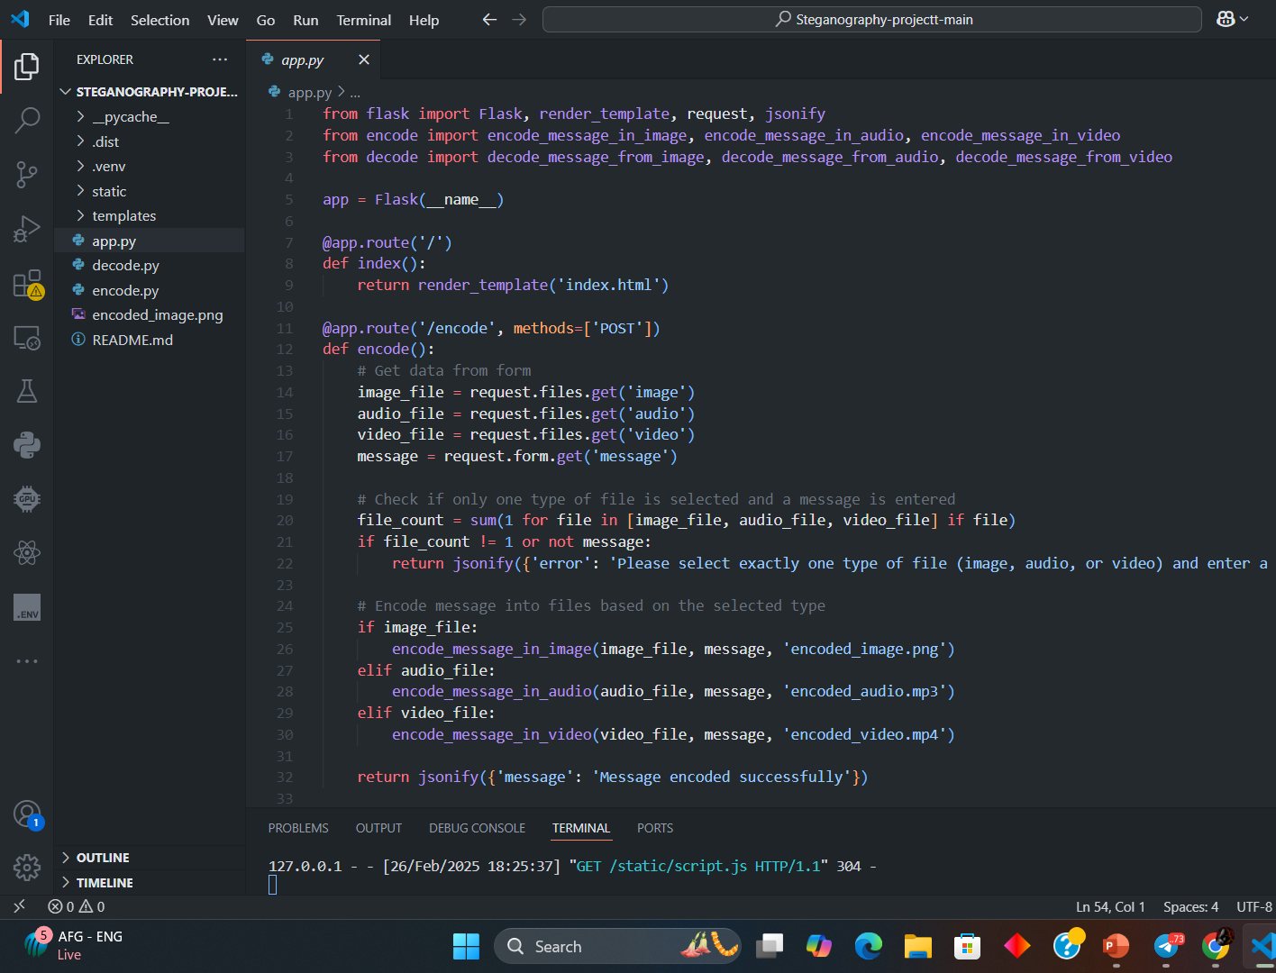
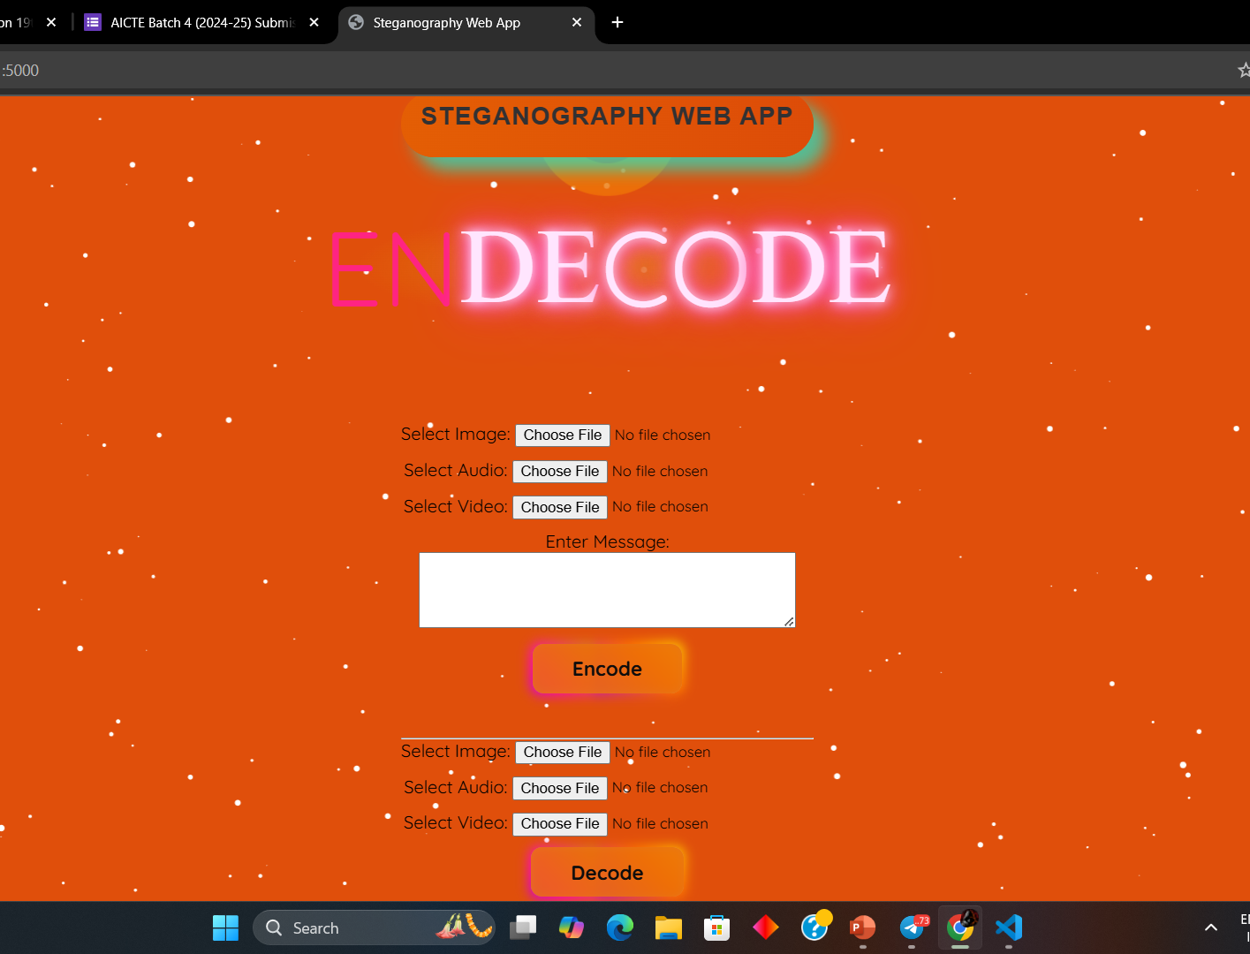
Results

Slide 8
Conclusion
Strengths:
Functional Core: The code effectively outlines the core logic for a steganography web application.
Multi-Media Potential: It lays the groundwork for supporting diverse media types.
Flask Framework: The use of Flask provides a lightweight and flexible foundation.
Modular Design: The separation of encoding and decoding logic enhances maintainability.
Weaknesses and Areas for Improvement:
Missing Frontend: A user-friendly interface is essential for end-user adoption.
Security Gaps: The absence of robust encryption and secure key management raises serious security concerns.
Lack of Error Handling and Validation: More comprehensive error handling and file validation are needed.
Performance Considerations: Optimization for handling large files is crucial.
Usability Deficiencies: Clear instructions, feedback mechanisms, and progress indicators are necessary.
Privacy concerns: User trust must be earned by ensuring that user data is not stored unnecessarily.

Slide 9
GitHub Link
https://github.com/Goppu05/AICTE_INTERNSHIP_IBM_CYBER_STEGO.git

Slide 10
Future scope
1. Enhanced Security:
Advanced Encryption: Implement robust encryption algorithms (e.g., AES, RSA) to protect the hidden data.
Secure Key Management: Develop secure key generation, storage, and exchange mechanisms.
Steganalysis Countermeasures: Incorporate techniques to make the hidden data more resistant to steganalysis.
Two-Factor Authentication: Add 2FA to protect user accounts.
Client side Encryption: Encrypt the data before it leaves the users browser.
2. Improved Functionality:
Expanded File Format Support: Add support for a wider range of file formats (e.g., PDFs, documents).
Metadata Manipulation: Allow users to modify or remove metadata from carrier files.
3. User Experience (UX) Enhancements:
Intuitive User Interface (UI): Develop a modern and user-friendly web interface with drag-and-drop functionality, progress indicators, and clear feedback.
Mobile Responsiveness: Ensure the application is accessible and usable on mobile devices.

Slide 11
THANK YOU

